Slide 1
Data Mining:
Concepts and Techniques
— Chapter 2 —
Jiawei Han, Micheline Kamber, and Jian Pei
University of Illinois at Urbana-Champaign
Simon Fraser University
©2011 Han, Kamber, and Pei. All rights reserved.

Slide 2
Chapter 2: Getting to Know Your Data
Data Objects and Attribute Types
Basic Statistical Descriptions of Data
Data Visualization
Measuring Data Similarity and Dissimilarity
Summary

Slide 3


Types of Data Sets
Record
  Relational records
  Data matrix, e.g., numerical matrix, crosstabs
  Document data: text documents: term-frequency vector
  Transaction data
Graph and network
  World Wide Web
  Social or information networks
  Molecular Structures
Ordered
  Video data: sequence of images
  Temporal data: time-series
  Sequential Data: transaction sequences
  Genetic sequence data
Spatial, image and multimedia:
  Spatial data: maps
  Image data:
  Video data:

Slide 4
Data Objects
Data sets are made up of data objects.
A data object represents an entity.
Examples:
  sales database: customers, store items, sales
  medical database: patients, treatments
  university database: students, professors, courses
Also called samples , examples, instances, data points, objects, tuples.
Data objects are described by attributes.
Database rows -> data objects; columns ->attributes.

Slide 5
Attributes
Attribute (or dimensions, features, variables): a data field, representing a characteristic or feature of a data object.
  E.g., customer _ID, name, address
Types:
  Nominal
  Binary
  Numeric: quantitative
    Interval-scaled
    Ratio-scaled

Slide 6
Attribute Types
Nominal: categories, states, or “names of things”
  Hair_color = {auburn, black, blond, brown, grey, red, white}
  marital status, occupation, ID numbers, zip codes
Binary
  Nominal attribute with only 2 states (0 and 1)
  Symmetric binary: both outcomes equally important
    e.g., gender
  Asymmetric binary: outcomes not equally important.
    e.g., medical test (positive vs. negative)
    Convention: assign 1 to most important outcome (e.g., HIV positive)
Ordinal
  Values have a meaningful order (ranking) but magnitude between successive values is not known.
  Size = {small, medium, large}, grades, army rankings

Slide 7
Numeric Attribute Types
Quantity (integer or real-valued)
Interval
    Measured on a scale of equal-sized units
    Values have order
      E.g., temperature in C˚or F˚, calendar dates
    No true zero-point
Ratio
    Inherent zero-point
    We can speak of values as being an order of magnitude larger than the unit of measurement (10 K˚ is twice as high as 5 K˚).
      e.g., temperature in Kelvin, length, counts, monetary quantities

Slide 8
Discrete vs. Continuous Attributes
Discrete Attribute
  Has only a finite or countably infinite set of values
    E.g., zip codes, profession, or the set of words in a collection of documents
  Sometimes, represented as integer variables
  Note: Binary attributes are a special case of discrete attributes
Continuous Attribute
  Has real numbers as attribute values
    E.g., temperature, height, or weight
  Practically, real values can only be measured and represented using a finite number of digits
  Continuous attributes are typically represented as floating-point variables

Slide 9
Chapter 2: Getting to Know Your Data
Data Objects and Attribute Types
Basic Statistical Descriptions of Data
Data Visualization
Measuring Data Similarity and Dissimilarity
Summary

Slide 10
Basic Statistical Descriptions of Data
Motivation
  To better understand the data: central tendency, variation and spread
Data dispersion characteristics
  median, max, min, quantiles, outliers, variance, etc.
Numerical dimensions correspond to sorted intervals
  Data dispersion: analyzed with multiple granularities of precision
  Boxplot or quantile analysis on sorted intervals
Dispersion analysis on computed measures
  Folding measures into numerical dimensions
  Boxplot or quantile analysis on the transformed cube

Slide 11
Measuring the Central Tendency
Mean
  The mean is the average of a data set
Median:
  Middle value if odd number of values, or average of the middle two values otherwise
Mode
  Value that occurs most frequently in the data

Slide 12
Example
Suppose we have the following values for salary (in thousands of dollars), shown in increasing order: 30, 36, 47, 50, 52, 52, 56, 60, 63, 70, 70, 110.
Mean ?
Median ?
Mode ?

Slide 13



Symmetric vs. Skewed Data
Median, mean and mode of symmetric, positively and negatively skewed data
symmetric
positively skewed
negatively skewed
Data Mining: Concepts and Techniques

Slide 14


Measuring the Dispersion of Data
Quartiles, outliers and boxplots
  Quartiles: Q₁ (25th percentile), Q₃ (75th percentile)
  Inter-quartile range: IQR = Q₃ – Q₁
  Five number summary: min, Q₁, median, Q₃, max
  Boxplot: ends of the box are the quartiles; median is marked; add whiskers, and plot outliers individually
  Outlier: usually, a value higher/lower than 1.5 x IQR
Variance and standard deviation (sample: s, population: σ)
  Variance: (algebraic, scalable computation)
  Standard deviation s (or σ) is the square root of variance s² ⁽or σ²⁾

Slide 15
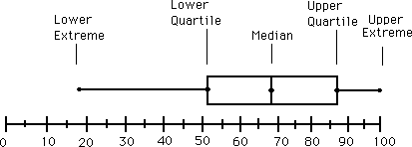
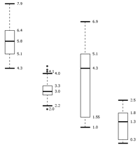
Boxplot Analysis
Five-number summary of a distribution
  Minimum, Q1, Median, Q3, Maximum
Boxplot
  Data is represented with a box
  The ends of the box are at the first and third quartiles, i.e., the height of the box is IQR
  The median is marked by a line within the box
  Whiskers: two lines outside the box extended to Minimum and Maximum
  Outliers: points beyond a specified outlier threshold, plotted individually

Slide 16
Graphic Displays of Basic Statistical Descriptions
Boxplot: graphic display of five-number summary
Scatter plot: each pair of values is a pair of coordinates and plotted as points in the plane
Histogram: x-axis are values, y-axis repres. frequencies

Slide 17
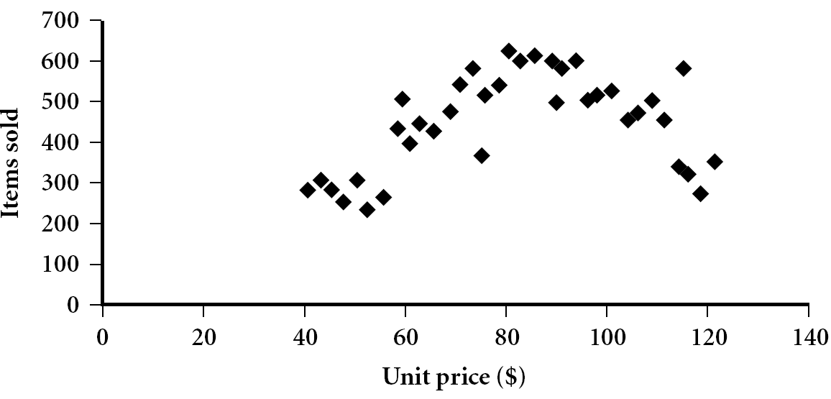
Scatter plot
Provides a first look at bivariate data to see clusters of points, outliers, etc
Each pair of values is treated as a pair of coordinates and plotted as points in the plane

Slide 18


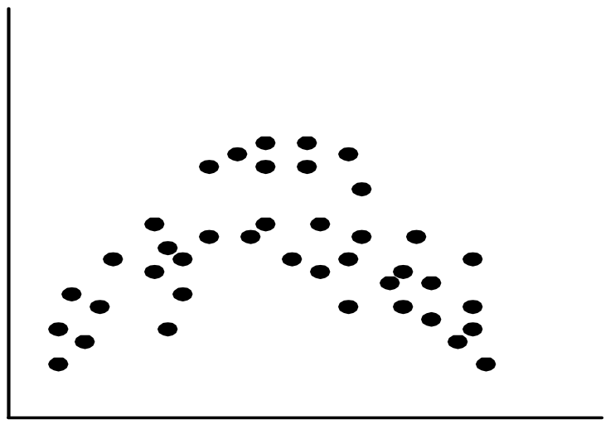
Positively and Negatively Correlated Data
The left half fragment is positively correlated
The right half is negative correlated

Slide 19


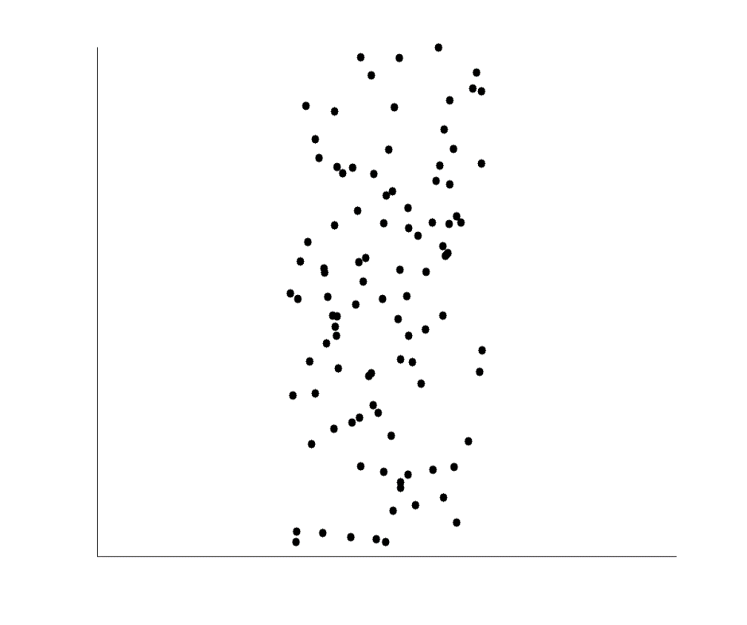
Uncorrelated Data

Slide 20
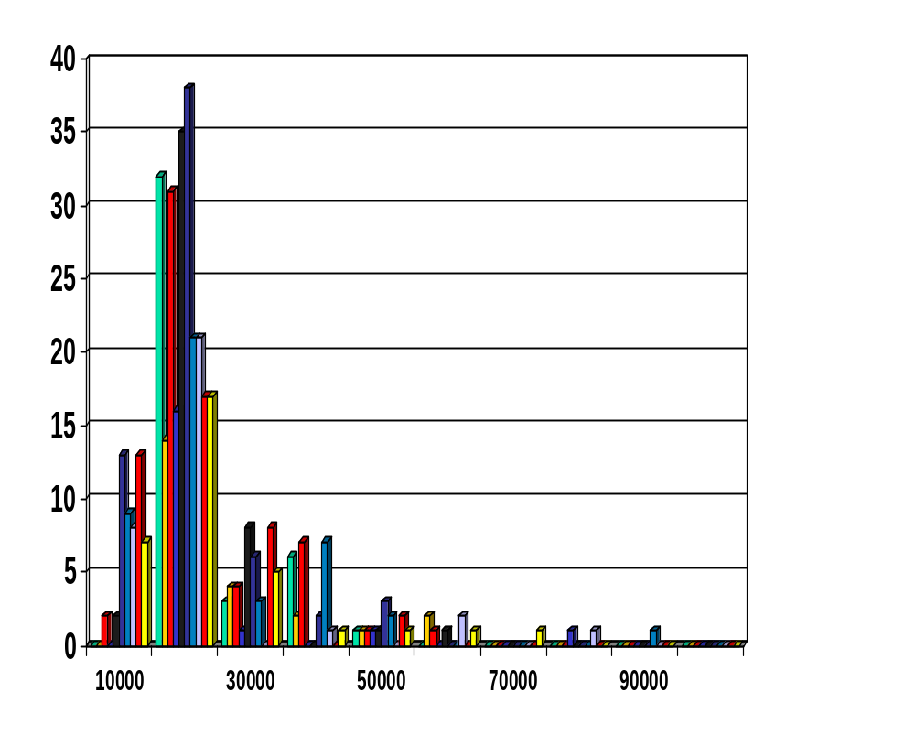
Histogram Analysis
Histogram: Graph display of tabulated frequencies, shown as bars
It shows what proportion of cases fall into each of several categories
Differs from a bar chart in that it is the area of the bar that denotes the value, not the height as in bar charts, a crucial distinction when the categories are not of uniform width
The categories are usually specified as non-overlapping intervals of some variable. The categories (bars) must be adjacent

Slide 21
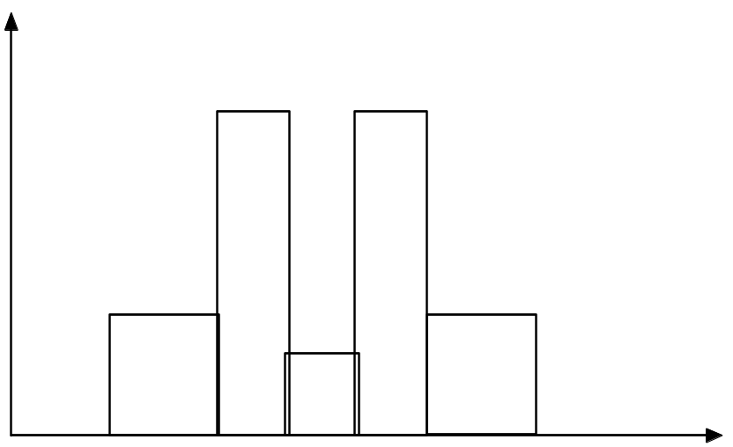
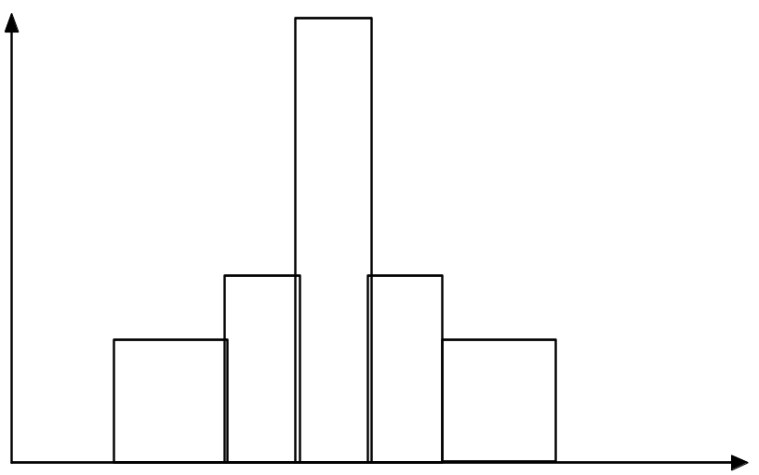
Histograms Often Tell More than Boxplots
The two histograms shown in the left may have the same boxplot representation
  The same values for: min, Q1, median, Q3, max
But they have rather different data distributions

Slide 22
Assignment 01:
The Quantile-quantile (q-q) plot in Python

